Slide 1


BANKCRUPTCY PREVENTION PROJECT

Slide 2
Table Of Contents:
Project architecture
Problem Statement
Business objective
Data Preprocessing
Visualization
Feature Selection
Model Selection
Deployment
Conclusion
Challenges faced and potential solutions

Slide 3
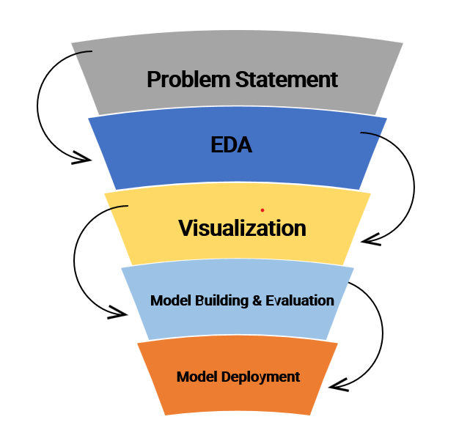
Project architecture

Slide 4

Problem Statement
To develop a machine learning model that accurately predicts whether a company is at risk of bankruptcy based on key financial and business indicators.

Slide 5

Business objective
Enable stakeholders (investors, creditors, and management) to identify high-risk companies early, make informed decisions, and mitigate financial losses.

Slide 6

Data Preprocessing:
Dataset contains 259 rows and 7 columns.
>>Independent Variable, X=6 Features
>> Dependent Variable, y = class
No Null Values.
Duplicates: 250 >> 103.
LabelEncoding : “Bankruptcy:0”, “Non-Bankruptcy:1”.
Standarization of data is done.

Slide 7
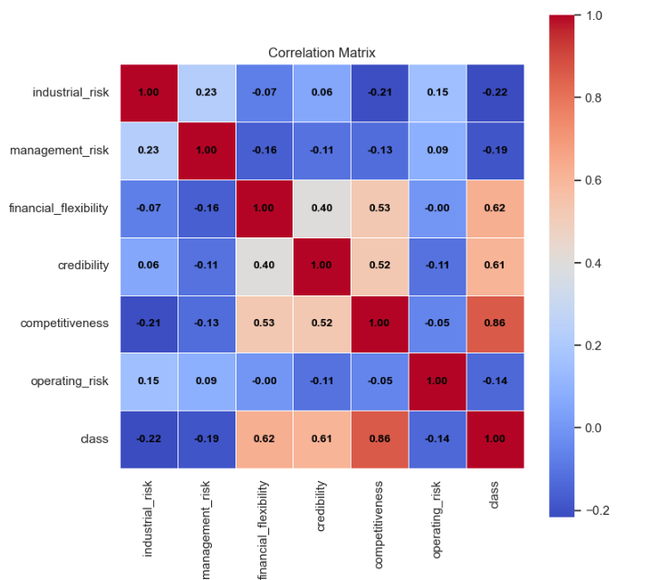
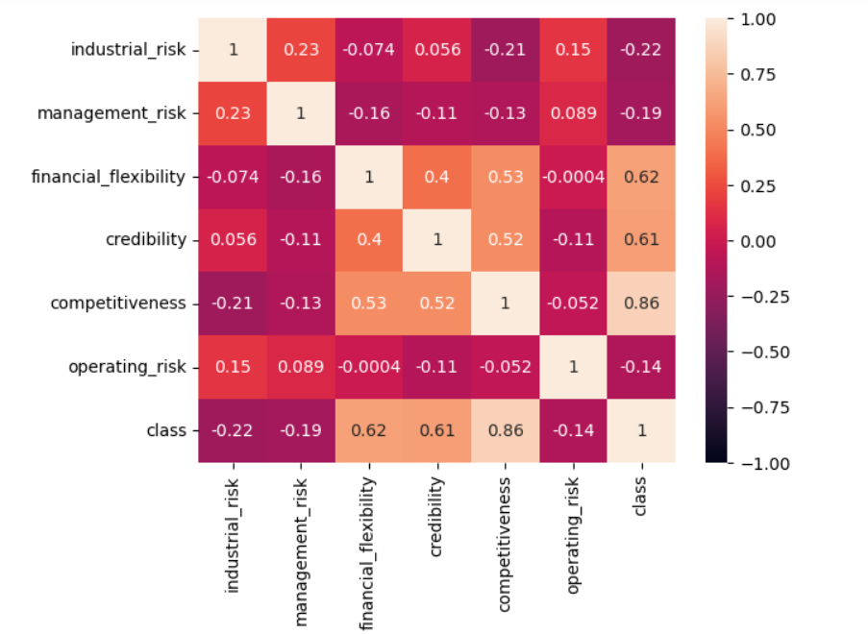
Correlation Matrix
Negative Relations with class variable:
Industrial risk
Management risk
Operating risk
Positive Relations with class variable:
Financial Flexibility
Credibility
Competitiveness

Slide 8
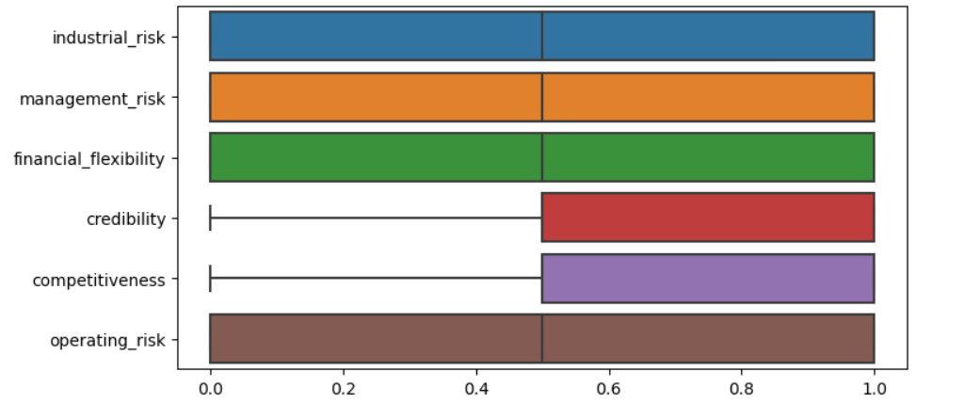
Box Plot For Outliers
No outliers are present in the data because it is mostly in 0.0,0.5 and 1.0.

Slide 9
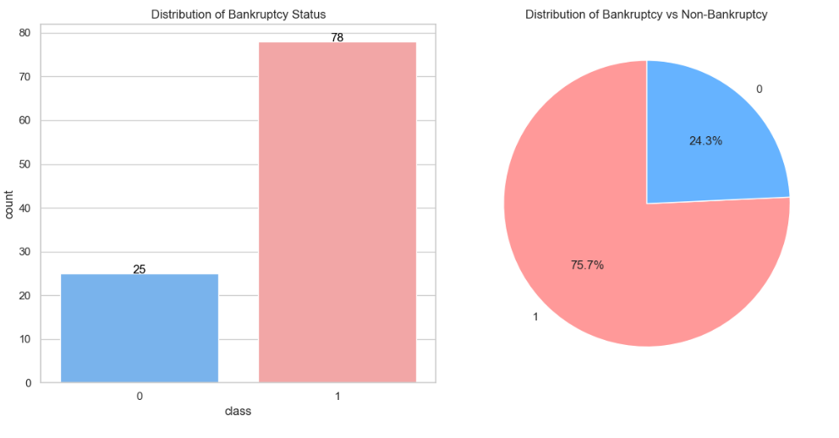
Data Distribution of class variable
Bankruptcy
Non - Bankruptcy
The Class variable is distributed in such a way that Bankruptcy(0) is occupied with 24.3% and Non-Bankruptcy(1) is occupied by 75.7%.

Slide 10
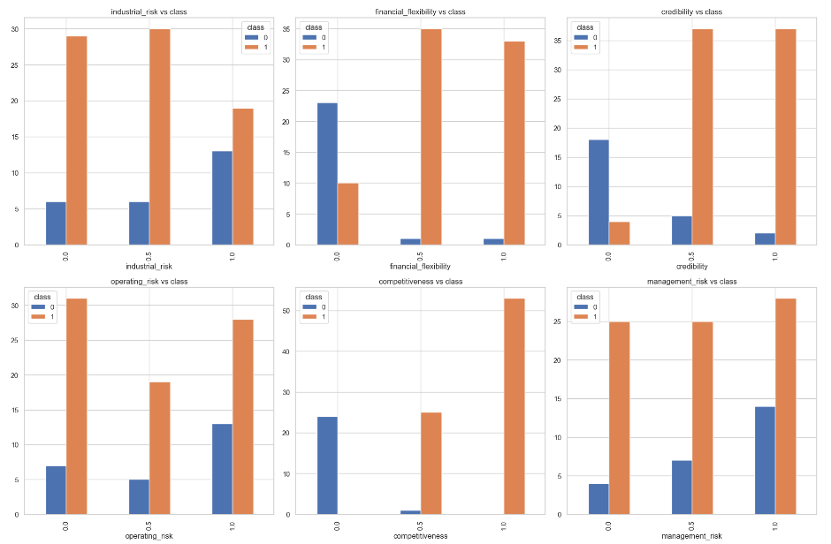
Data Distribution with class variable
Higher levels of industrial, operating, and management risk are associated with increased bankruptcy cases, while higher credibility, financial flexibility, and competitiveness correlate with non-bankruptcy.
Overall, lower risk and higher competitiveness/credibility reduce the likelihood of bankruptcy.

Slide 11
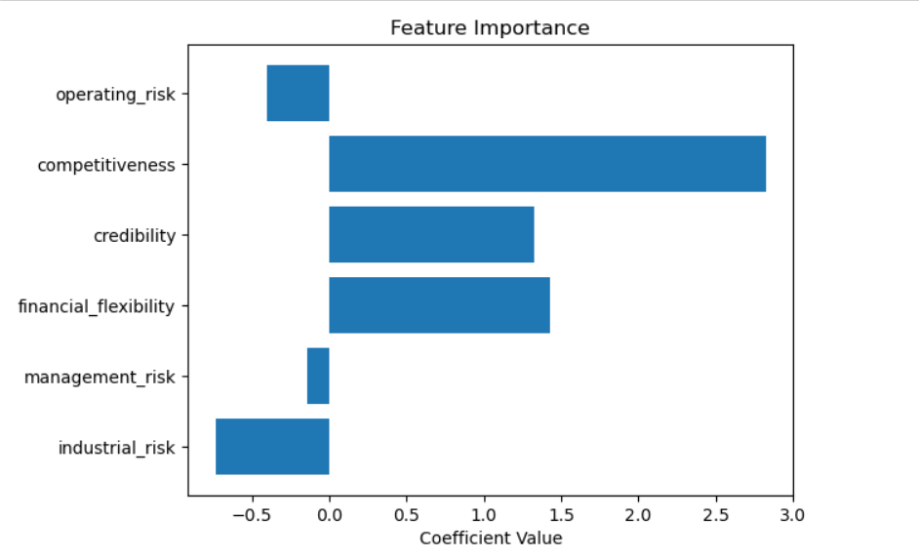
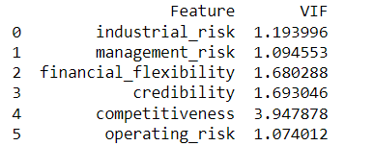
Feature Selection
By considering VIF and Feature importance , Removing some variables helps improvement of the model.
Hence, we removed variables like
Operating risk
Management risk
Industrial risk.

Slide 12
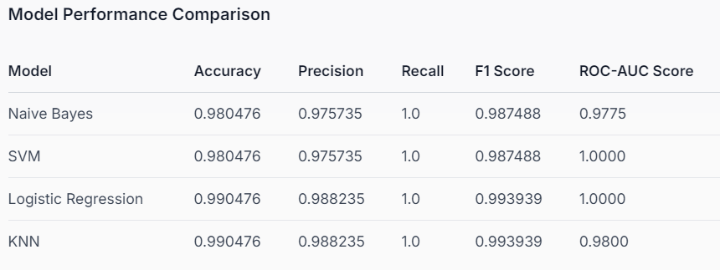
Model Selection
Considering all metrics KNN seemed like better option.

Slide 13
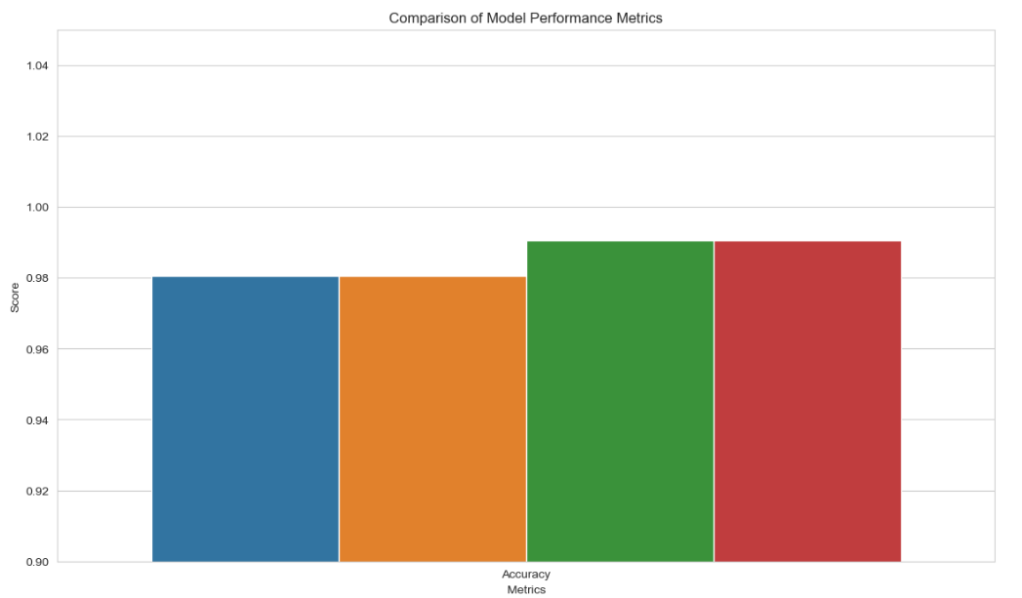
Conclusion
Our final conclusion is K- Nearest Neighbour Model.
For logistic there is a chance of getting effected because of outliers.
For continuous response variable KNN is better.
Knn is less sensitive for outliers.
Fast and effective for complex datasets also.

Slide 14
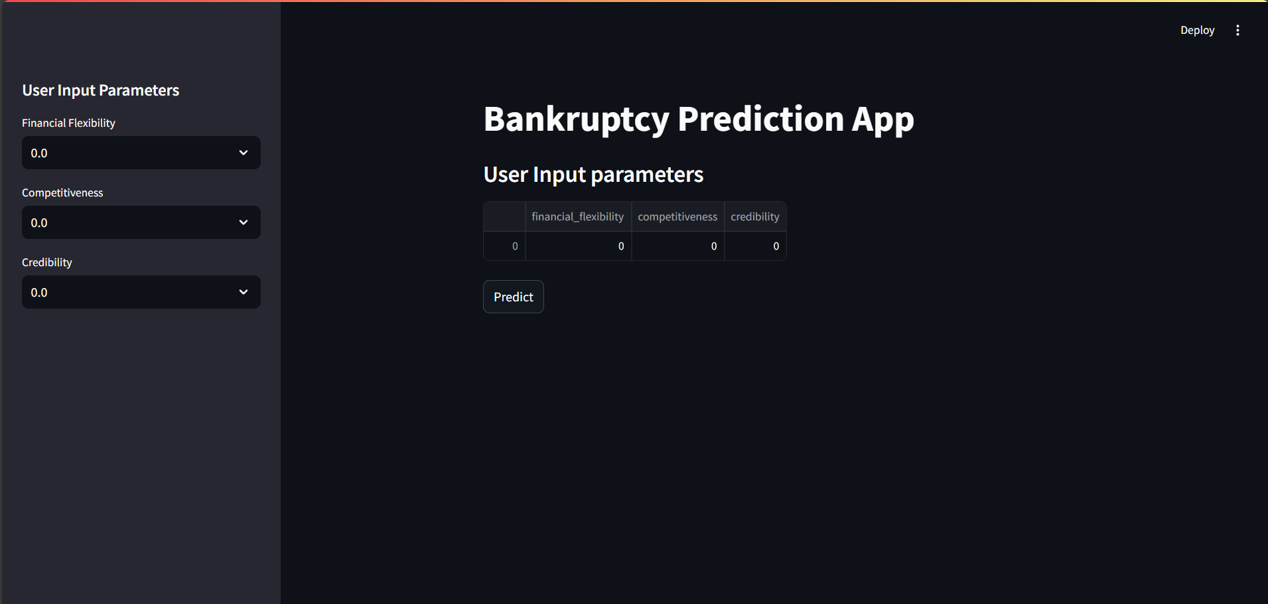
Deployment

Slide 15
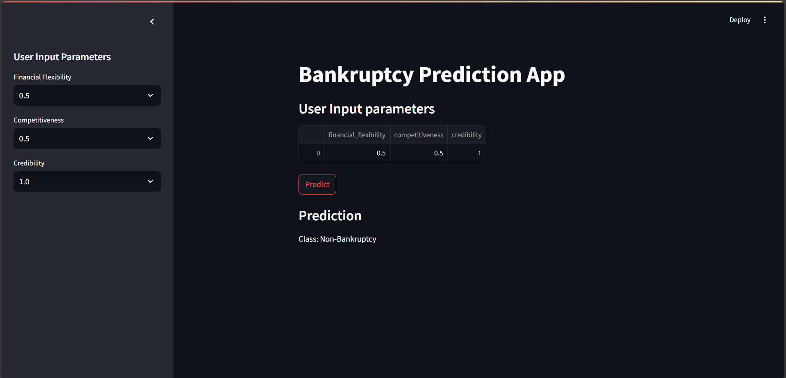

Slide 16
Challenges faced and potential solutions
As data is in object form it was a bit difficult convert it to choose which method to use.
Label encoder
Our team got struck at the point whether choose the data with or without duplicates.
We removed duplicates
After performing hyper parameter tuning it was challenging to select considerable parameters.
We considered two main parameters
And as every model got similar values for basic metrics it was hard to select a single model.
Based on ROC value
The main challenge was deployment it was a bit difficult to select a platform, and loading the data as excel, model building and prediction as it should be included with user interface also.
Streamlit was easy to adopt

Slide 17

Our Team:
Samiksha S. Janjirkar Bharad Archana Vilas Veena Kandalam P Raghavendra Aarzoo fatima khan Nagella Naga Prasanna Shaik Abdul Raheem

Slide 18


